Slide 1
Understanding Key Decision Factors to Attract and Retain International Students in CSUEB
Team Members:
Priyanka Singh
Shrikirti Vijayendra
Tia Cao
Vinmathi Iyappan

Slide 2
Project Overview and Objectives
Client: California State University, East Bay
Target Audience: Current, prospective, and international students
Objectives:
Identify the key factors influencing international students decision to choose the College of Business.
Compare the college's performance with similar institutions.
Provide actionable recommendations to enhance marketing, admissions, and student services.
Increase overall satisfaction and retention of international students.

Slide 3
Problem Statement
California State University, East Bay has notable international student population, presenting a valuable opportunity to further understand the key factors that attract these students to the institution.

Slide 4
Research Questions
What are the key factors influencing international students to choose the College of Business and Economics over other institutions?
How do factors such as tuition fees, course offerings, location, and college reputation impact the decision-making process of international students?
What improvements can be made in the college’s marketing, admissions, and student services to enhance satisfaction and retention?

Slide 5
SWOT Analysis
Strengths Strong brand perception and positive reputation among students Comprehensive university support across various areas Robust Diversity, Equity, and Inclusion (DEI) initiatives that are "very supported" by students Good communication of visa information to international students | Weaknesses Career support services perceived as lacking by some students Alumni support rated as only "somewhat" satisfactory by the majority of students Limited understanding of international students' decision-making factors (as indicated by the need for this research)
Opportunities Enhance career support services to meet student expectations Strengthen alumni relations and support programs Tailor marketing strategies to emphasize key decision factors like tuition fees, coursework, and location Develop targeted programs or services based on the most desired combination of guidance (resume review + interview prep) | Threats Competition from other institutions that may offer lower tuition fees (given that tuition is the most important factor for students) Potential changes in visa regulations or international student policies that could affect enrollment Economic factors or global events that might impact international student mobility Shifting student preferences or priorities in choosing educational institutions

Slide 6
Research Instruments (1)
Surveys:
Purpose: Understand key decision factors influencing international students' choice of college.
Method: Online questionnaires distributed to current and prospective international students.
Question Types: Likert scale items, multiple-choice questions, and demographic information.
Secondary Data Sources:
Purpose: Analyze historical trends in admission and retention.
Data: Historical data from the College of Business and Economics.

Slide 7
Research Instruments (2)
Interviews:
Purpose: Gain deeper insights into the experiences and perceptions of international students.
Method: Conducted with selected students
Literature Review:
Purpose: Contextualize findings through existing research on international student decision-making processes.
Sources: Review of research studies and case studies related to student choices.

Slide 8
Literature Review
Perkins and Neumayer (2014) found that institutions with dedicated international student offices and mentorship programs reported higher levels of student satisfaction and retention. Support in navigating visa processes and cultural adjustment is critical for easing the transition to a new educational environment (Glass et al., 2015).
Mazzarol and Soutar (2002) emphasize that effective branding and communication strategies can significantly influence international student decisions. Social media plays a crucial role in outreach, with studies indicating that platforms like Instagram and WeChat are vital for engaging prospective students (Suh et al., 2020)
The influence of alumni on recruitment cannot be underestimated. Studies show that successful alumni can serve as powerful ambassadors for their institutions, attracting new students through testimonials and networking opportunities (Hemsley-Brown & Oplatka, 2015).

Slide 9
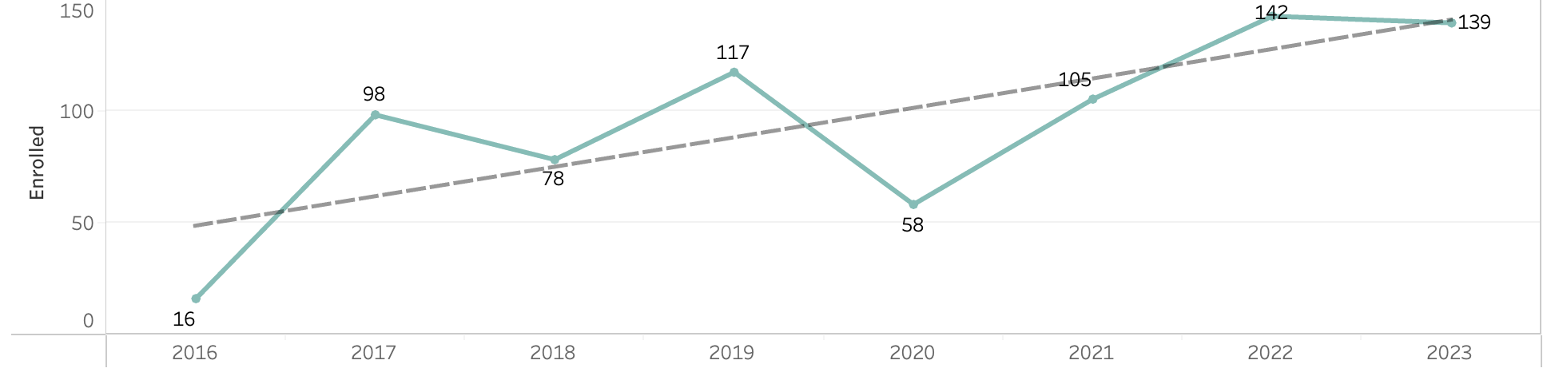
International Students in MSBA
Notes:
In 2023, out of 151 students enrolled, 139 are international students

Slide 10

Data – about survey
Our survey consisted of 9 questions and to capture a range of responses, we employed different types of scales:
Nominal Scale: This was used for simple categorization, such as identifying whether a respondent is an international student.
Ordinal Scale: Applied to questions where respondents were asked to rank or rate their experiences or perceptions, such as rating the college's reputation.
Likert Scale: Used for questions measuring the degree of agreement with various statements about concerns, issues, and support.
Interval Scale: Incorporated for questions assessing the importance of certain decision factors, like tuition fees and course offerings.
These diverse scales allowed us to gather both qualitative and quantitative insights, ensuring a comprehensive understanding of respondents' views.
Link to the survey: https://forms.gle/6L9fYAU9RMnNJroi6

Slide 11
Ethical Consideration
Anonymity: No personal information was collected from participants; all responses were anonymous to protect privacy.
Confidentiality: Data collected will be used solely for research purposes and will not be linked to any individual.
Voluntary Participation: Participants were informed about the nature of the survey and took part voluntarily without any obligation.
Data Security: All survey data is securely stored and will not be shared with third parties.

Slide 12
Key Insights

Slide 13
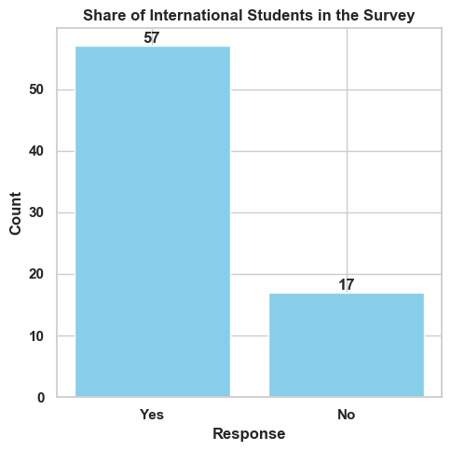
Survey Participation
Total Participants: 74
Total international students:57
Total Domestic students:17

Slide 14
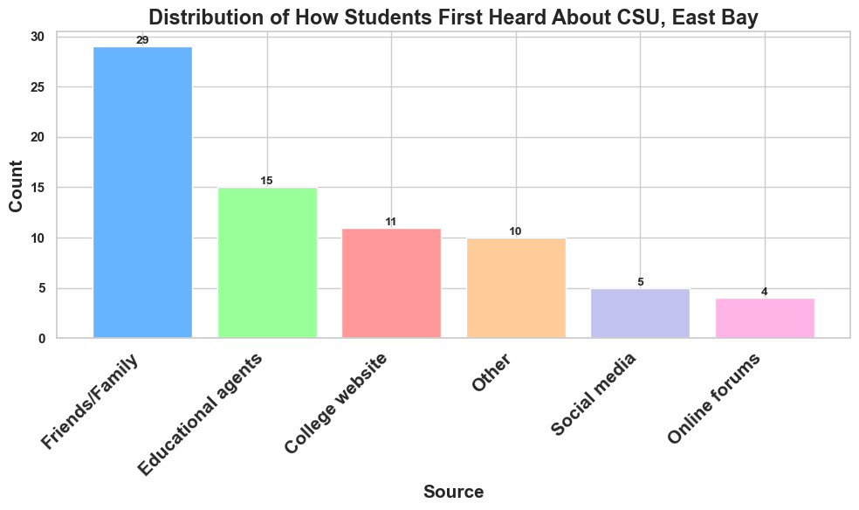
How Students Heard About CSUEB
Notes:
Bar chart showing how students heard about CSUEB. This is majorly from Friends/Family.

Slide 15
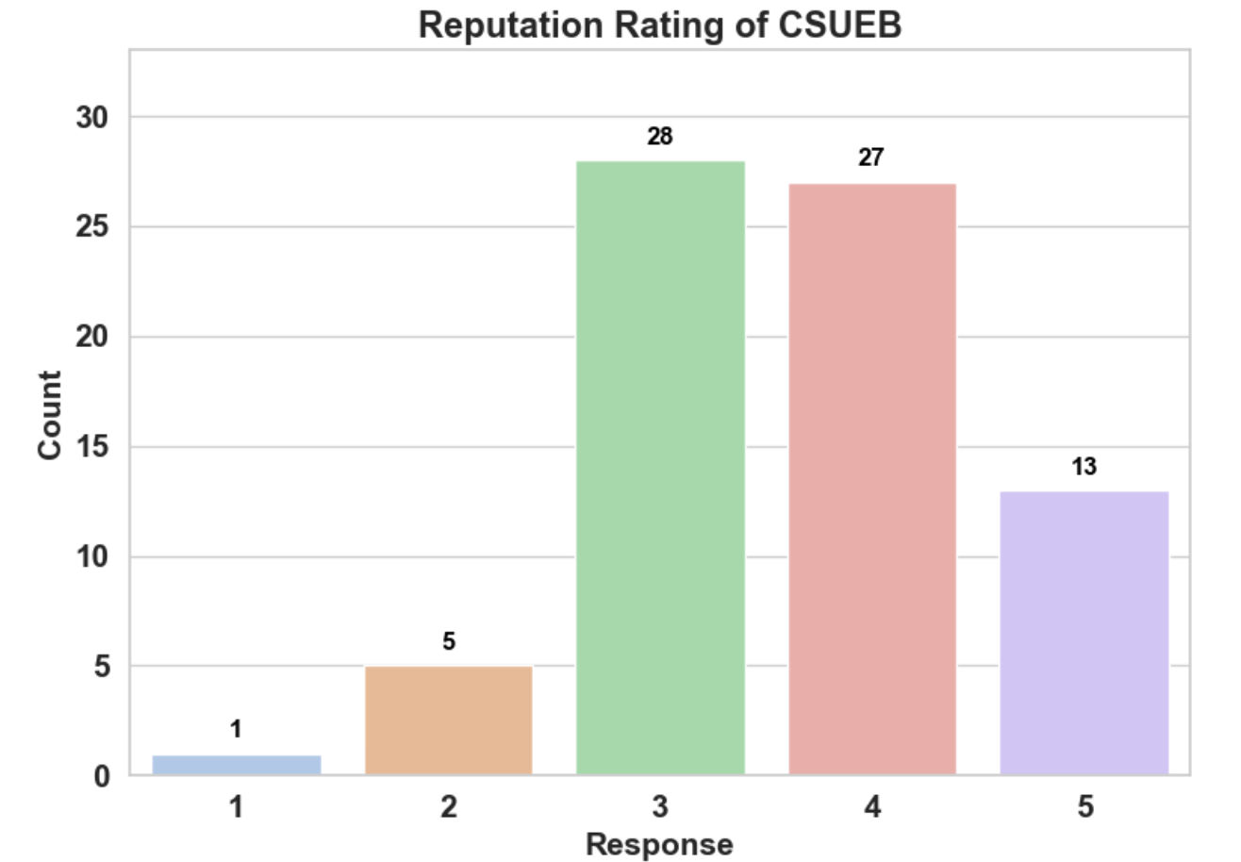
Student Perception of CSUEB Reputation
Notes:
The brand perception is reflected through the reputation rating of the university by the students. Most students have rated 3 (28) while some have rated for 4 (27) and 1-1 and for 2 - 5 people have voted and for 5 - 13.

Slide 16
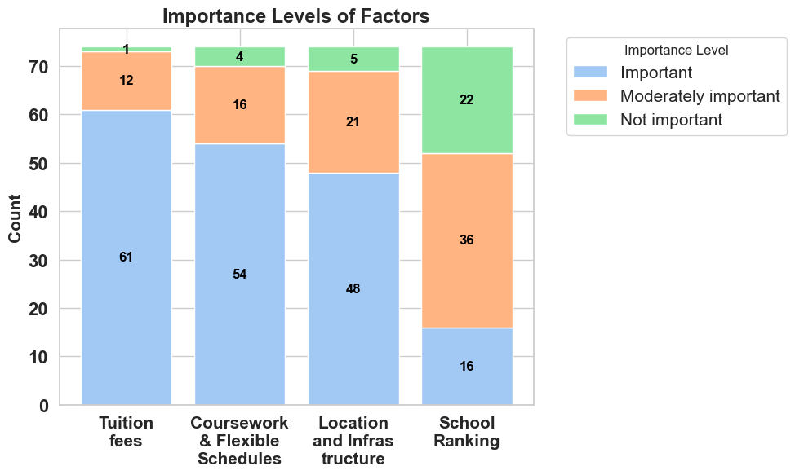
Factors Influencing Students Decision
Ranking - Tuition fees, Coursework & Flexible Schedules, Location and Infrastructure, School Ranking

Slide 17
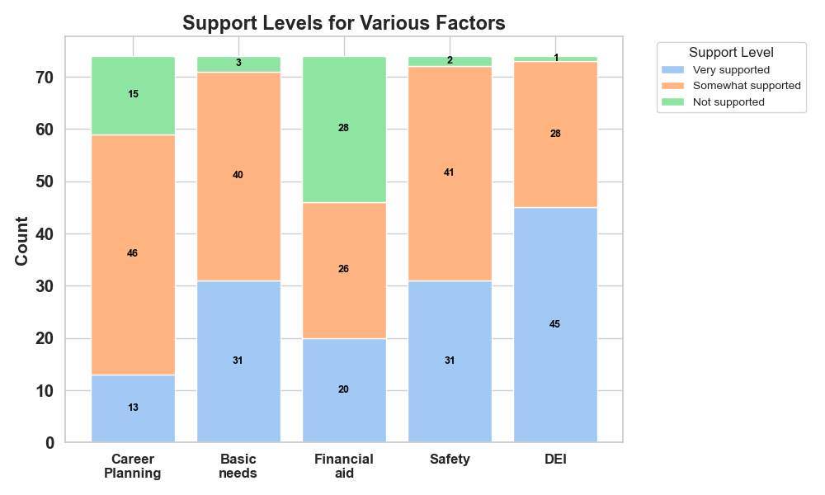
Student Perception on University Support

Slide 18
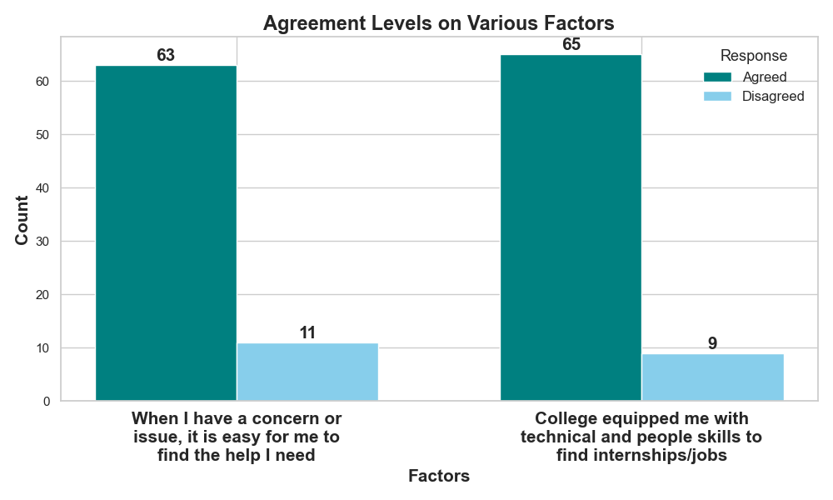
Student Awareness

Slide 19
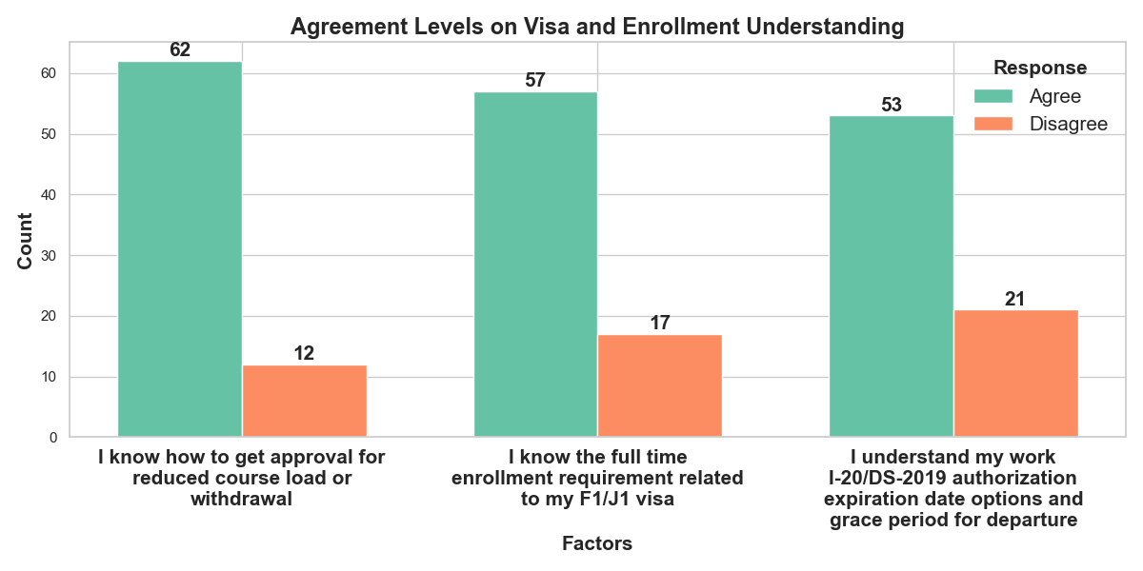
Understanding Immigration Status

Slide 20
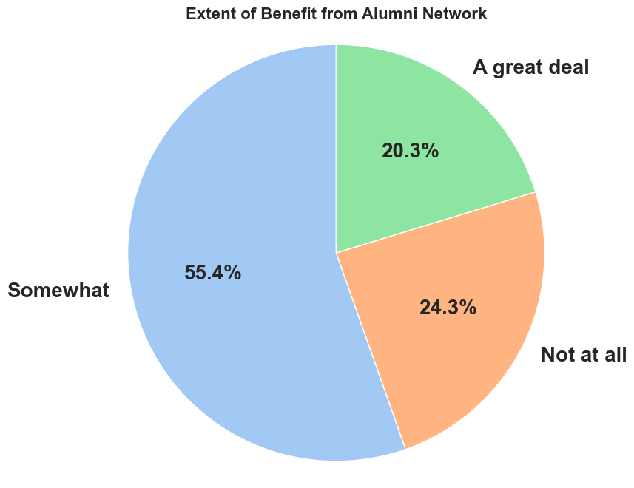
Extent of Benefit from Alumni Network

Slide 21
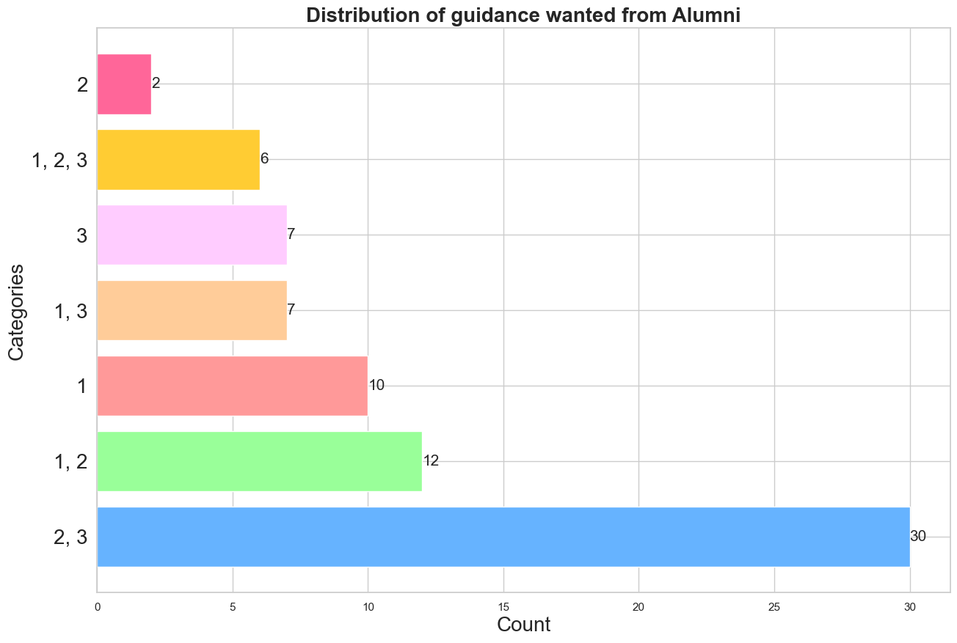
Expectations from Alumni Network
1 - Mentorship opportunities
2 - Resume reviews and interview preparation
3 - Alumni-hosted webinars or workshops

Slide 22

Insights from the Survey
Student Awareness: Most students learn about CSU, East Bay through personal recommendations, indicating a strong word-of-mouth reputation.
Brand Perception: The majority rate the university's reputation neutrally at 3, with opportunities to enhance communication of its strengths.
Key Decision Factors: Tuition fees are the top influence on student choice, followed by flexible coursework and location, while ranking is moderately important.
Diversity and Inclusion: Students feel well-supported in diversity and inclusion, but career support services need improvement.

Slide 23
Insights from the survey
Student Support: CSU, East Bay effectively addresses a broad range of student concerns, fostering a supportive environment.
Visa Knowledge: Most international students are well-informed about visa requirements, reflecting effective communication from support teams.
Alumni Engagement: While alumni support is felt, there is significant potential to strengthen alumni relations for better career guidance.
Guidance Preferences: Resume reviews and interview preparation are the most sought-after forms of support from alumni.

Slide 24
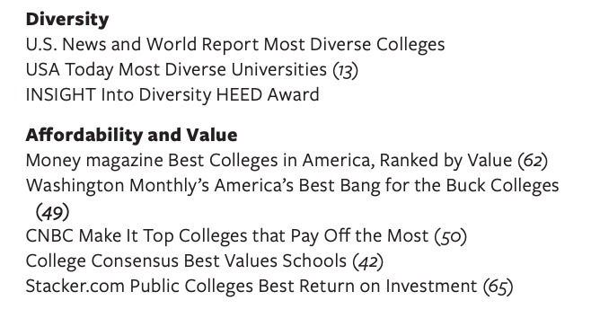
Interview & Observation Highlights
Location & Convenience: Students value CSU East Bay’s convenient location and flexible evening classes, making it ideal for working professionals.
Tuition Fees: International students appreciate the affordability of tuition compared to other Bay Area schools.
Reputation: There’s optimism that CSU East Bay can further enhance its reputation and attract more students.
Support & DEI: Strong support for DEI and basic needs was appreciated by students.
Marketing: Leveraging platforms like Instagram and WhatsApp could help increase visibility to international students.

Slide 25
CSUEB Value Proposition
Looking at the insights from survey and the general motto of CSUEB, we have come up with a value proposition for CSUEB.
- For: Prospective students seeking an affordable yet high-quality education in a diverse and inclusive environment.
- Who: Want to pursue higher education but are concerned about tuition costs, career support, and feeling included.
- Our product/service: CSU, East Bay offers affordable tuition, flexible coursework, and comprehensive support services.
- That: Ensure students receive a well-rounded education, feel supported in their personal and professional growth
- Unlike: Other universities that may prioritize ranking or are cost-prohibitive,
- We: Focus on affordability, inclusivity, and comprehensive student support to ensure students are prepared for their careers in a supportive, diverse environment.

Slide 26
Limitations
Sample Size: The limited sample may not fully represent all international students, affecting generalizability.
Time Frame: A snapshot of opinions at a specific moment, not accounting for potential changes over time.
Response Bias: The survey results might be affected by self-selection bias, where students who chose to respond may have different characteristics or opinions compared to those who didn't participate
Exploration Opportunities: While we identified key preferences, there’s room for deeper exploration of the reasons behind these insights in future studies.

Slide 27
Recommendations
1. Enhance Career Support Services
Develop a comprehensive career mentorship program pairing students with industry professionals
Organize more industry-specific job fairs and networking events for international students
2. Strengthen Alumni Relations
Create an alumni ambassador program to connect current students with successful graduates.
Implement a regular alumni guest speaker series to share career insights and opportunities
3. Improve Financial Guidance
Provide more detailed information about tuition fees and available financial aid options early in the admissions process
Offer workshops on financial planning and budgeting for international students
4. Implement Continuous Feedback System
Establish regular surveys and feedback sessions to stay updated on international student needs and satisfaction levels

Slide 28
What We Have Learned
Survey Design and Analysis
Practical experience in creating and analyzing surveys to gather actionable marketing insights.
Value Proposition Development
Crafted a specific value proposition for CSUEB based on survey insights and the university's strengths.
Actionable Recommendations
Developed specific, data-driven recommendations to enhance marketing, admissions, and student services.
Literature Review Analysis
Explored existing research on factors influencing international student decisions to inform survey design and analysis.

Slide 29
Citations
https://www.csueastbay.edu/about/files/docs/2024-factsbk.pdf
Glass, C. R., & others. (2015). International Students: A Comprehensive Review of the Literature. Journal of International Students, 5(1), 1-22.
Suh, J., & others. (2020). The Role of Social Media in International Student Recruitment. Journal of Higher Education Policy and Management, 42(2), 121-135.
Hemsley-Brown, J., & Oplatka, I. (2015). University Choice: What Do We Know, What Don’t We Know, and What Should We Do? International Journal of Educational Management, 29(2), 147-158.

Slide 30
Thank you
Please keep this slide for attribution

